Slide 1

Web technologies using java
Course 4 – spring boot, spring mvc

Slide 2
agenda
Spring boot Core features
Getting started
spring mvc intro
Web aware bean scopes

Slide 3

Spring boot Core features
1. Simplified dependency management
avoids mismatch between different versions of dependencies
Spring Boot starters: provide a group of related functionalities in a single application dependency (spring-boot-starter-web)
dramatically diminishes the overhead of testing, maintaining, and upgrading them
. 2. Executable JARs for Simplified Deployment
single Spring Boot JAR with all dependencies makes the deployment easy.
. 3. Autoconfiguration
developer’s superpower
convention over configuration: if you follow simple, well-established and documented conventions to do something, the configuration code you must write is minimal

Slide 4
Getting started
Maven or Gradle project
The Spring Initializr: https://start.spring.io
@SpringBootApplication: upon startup, a Spring Boot app checks the environment, configures the application, creates the initial context, and launches the Spring Boot application
@Configuration: tags the class as a source of bean definitions for the application context.
@EnableAutoConfiguration: tells Spring Boot to start adding beans based on classpath settings, other beans, and various property settings.
@ComponentScan: tells Spring to look for other components in the package from the same level as the application class.

Slide 5
Spring mvc intro
MVC: Model-View-Controller
a pattern and an implementation
Spring MVC framework is request-driven, designed around a central Servlet that dispatches requests to controllers
User interaction can be done in multiple ways (server-side rendering of the HTML)
JSP (Java Server Pages)
template engines: Thymeleaf

Slide 6
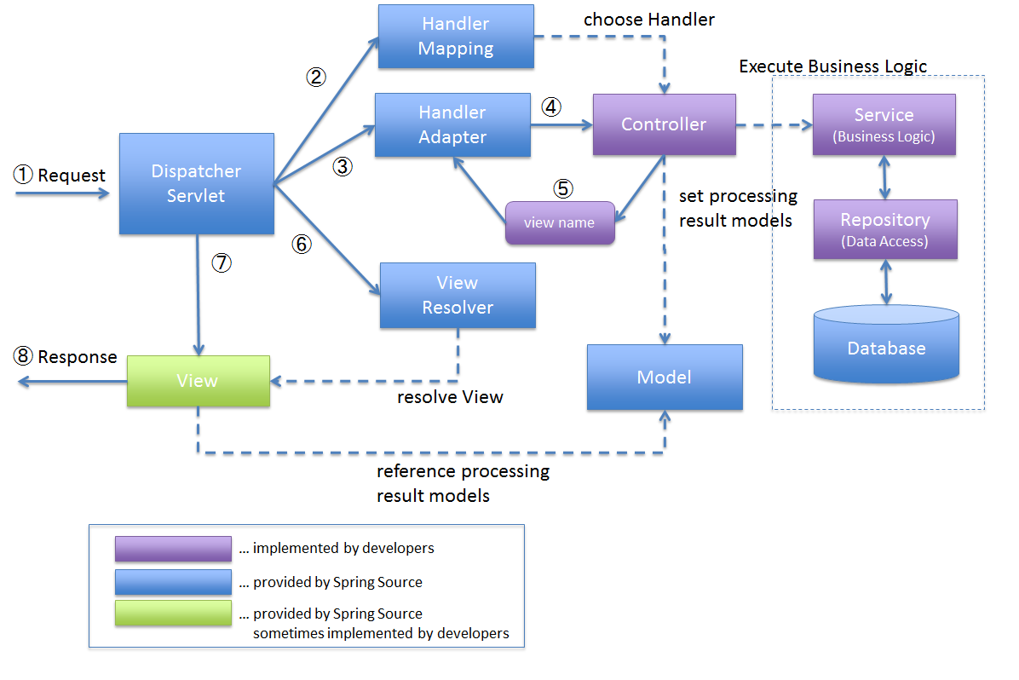
Spring mvc intro

Slide 7
Spring mvc intro
Spring MVC project with Spring Boot and Thymeleaf
spring-boot-starter-web dependency, which auto-configures:
Dispatcher Servlet
Error Page
Web Jars to manage your static dependencies
Embedded Servlet Container - Tomcat is the default
spring-boot-starter-thymeleaf
integration between Spring MVC and Thymeleaf template engine

Slide 8
Spring mvc intro
General structure of a Controller method
annotated with @Controller
annotated with @RequestMapping
ensures that the HTTP requests made at the specified url are mapped to the method
@Model:
automatically autowired parameter in the controller methods
used to expose an object to the view template
@ModelAttribute:
automatically autowired parameter in the controller methods
used to receive an object populated in the view template
returns a String, which is the name of the template (templates are placed under src/main/resources/templates)

Slide 9
Web aware bean scopes
Request:
bean is scoped at the HTTP request level
a new instance per each HTTP request
when the request completes processing, the bean that is scoped to the request is discarded
Session
bean is scoped at the HTTP Session level
a new instance for the lifetime of a single HTTP Session
when the HTTP Session is eventually discarded, the bean that is scoped to that particular HTTP Session is also discarded
Application
bean is scoped at the ServletContext level
a new instance for the entire web application

Slide 10
bibliography
Spring in Action, by Craig Walls
https://docs.spring.io/spring-framework/docs/5.3.x/reference/html/web.html#mvc
https://www.thymeleaf.org/documentation.html
https://docs.spring.io/spring-framework/docs/5.3.x/reference/html/core.html#beans-factory-scopes-other

Slide 11

Q&A

Slide 12
THANK YOU
DANIELA spilcĂ

